Slide 1
My Portfolio
Samarth Yuvraj Bhatnagar

Slide 2
About Me
Passionate Learner
Interactive Websites
Web Development, Programming, Robotics
Applications, Python, JavaScript

Slide 3
Skills
HTML
CSS
JavaScript
Git/GitHub

Slide 4

Learning Goals
1
Full-Stack Web App
2
Learn React.js
3
Learn Python for AI

Slide 5
Introduction to Design Thinking
Empathize
1
2
Define
Ideate
3
4
Prototype
Test
5

Slide 6
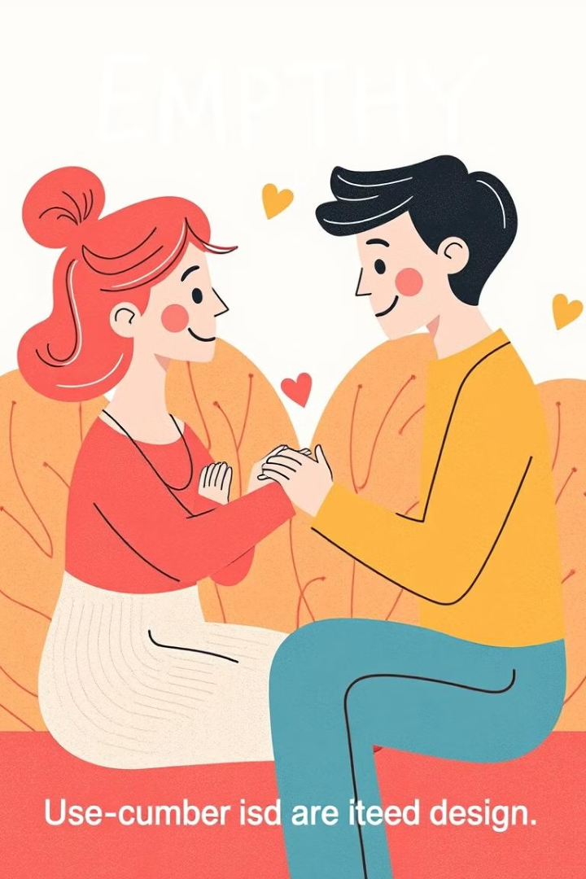
Empathize
Understand users and their needs by observing, engaging, and empathizing with them.

Slide 7
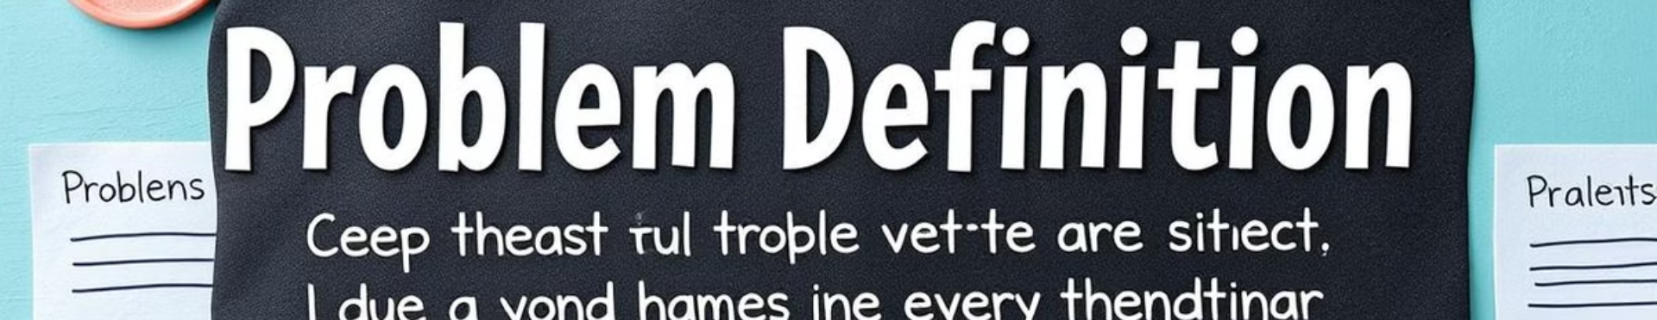
Define
Clearly defining the problem statement based on user insights.

Slide 8

Ideate
Brainstorming and generating a wide range of creative ideas for solving the problem.

Slide 9

Prototype
Creating simple prototypes or testable models of the ideas to explore solutions.

Slide 10
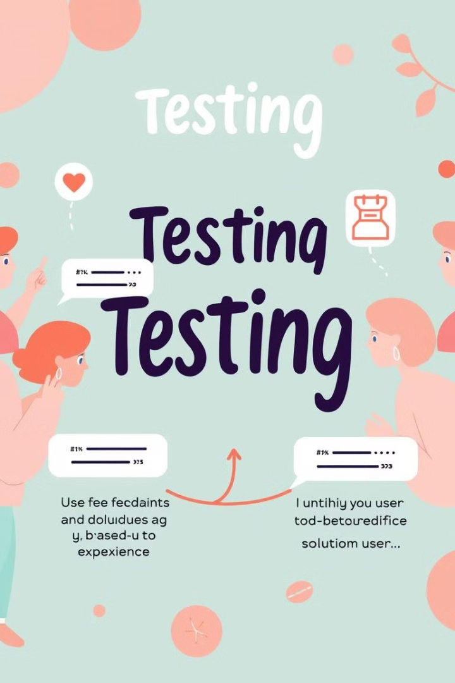
Test
Testing the prototypes with users to gather feedback and refine the solutions.

